Slide 1
4. Nonstationary Processes
ECFI 2019-20
Class 25 March 2020

Slide 2
4.1. Types of nonstationarity
Usually, observed time series are nonstationary, and we transform them so we can use stationary models such as ARMA
Nonstationarity:
In mean
In variance
Both
ww04.dat : US women unemployment
garch.tsm : stock returns
ww06.dat : US tobacco production

Slide 3
4.1.1. Deterministic trends
Deterministic function $Z_{t}=f\left(t\right)+u_{t}$
Such as linear, quadratic, polynomial… $Z_{t}=a+bt+ct^{2}+… +u_{t}$
Trend fitting is usually not advisable in time series (autocorrelation…)
but possible and sometimes useful
Let’s try with series ww04, women unemployment
Linear fit
Quintic fit
Cubic fit
Quadratic fit

Slide 4
4.1.2. Stochastic trends
Some time series become stationary after differencing
Differencing operator: $∇=\left(1−B\right)$
If we difference d times we have $∇^{d}={\left(1−B\right)}^{d}$
$Δ^{d}={\left(1−L\right)}^{d}$ equivalent notation
Z_t | Z_t - Z_t-1
5
7 | 2
6 | -1
3 | -3
7 | 4
5 | -2
8 | 3
3 | -5
5 | 2
9 | 4
8 | -1

Slide 5
4.1.2. Stochastic trends
Some time series become stationary after differencing
Differencing operator: $∇=(1−B)$
ww04.dat : US women unemployment
ww04.dat : US women unemployment change

Slide 6
4.1.2. Stochastic trends
Some time series become stationary after differencing
Differencing operator: $∇=\left(1−B\right)$ $Δ=\left(1−L\right)$ equivalent notation
And then, we can use ARMA models, if
If $∇Z_{t}=\left(1−B\right)Z_{t}∼stationary ARMA$
i.e., $φ\left(B\right){(1−B)Z}_{t}=θ\left(B\right)a_{t}$
where $ψ\left(B\right)=φ\left(B\right)(1−B)$ is an AR operator with a unit root (so, nonstationary)
where is the unit root?
$B=1 ⇒ψ\left(B\right)=0$
In models such as this, levels change stochastically

Slide 7

In models such as this
${\left(1−B\right)}^{d}φ\left(B\right)Z_{t}=θ\left(B\right)a_{t}$,
levels change stochastically.
Simplest example:
RANDOM WALK
$\left(1−B\right)Z_{t}=a_{t}$ or $Z_{t}={Z_{t−1}+a}_{t}$
RANDOM WALK WITH DRIFT $θ_{0}$
$\left(1−B\right)Z_{t}={θ_{0}+a}_{t}$ or $Z_{t}={Z_{t−1}+θ_{0}+a}_{t}$

Slide 8
If we understand well the relationships among WN, RW, and AR(1), then we understand 90% of Time Series 101
1st: with $d=1$, if $Z_{t}$ is a RW ${\left(1−B\right)}^{d}Z_{t}=a_{t}$
Then, the differences of $Z_{t}$ are a WN:
${ Z}_{1}−Z_{0}=a_{1},{ Z}_{2}−Z_{1}=a_{2},$ ${ Z}_{3}−Z_{2}=a_{3},$…
2nd: and so, the integration of $a_{t}$ is a RW:
$Z_{0}=0, { Z}_{1}=a_{1},$ $Z_{2}=a_{1}+a_{2},{ Z}_{3}=a_{1}+a_{2}+a_{3},$ $Z_{t}=\sum_{i=1}^{t}{a_{t}}$, …
3rd: If we let $φ_{1}→1$, an AR(1) becomes a RW: $Z_{t}={{φ_{1}Z}_{t−1}+a}_{t}→Z_{t}={Z_{t−1}+a}_{t}$

Slide 9

4.2. ARIMA models
Important definition: We say the process $Z_{t}$ follows an ARIMA(p,d,q) if $∇^{d}Z_{t}$ follows a stationary (causal) and invertible ARIMA(p,q), i.e., if the following differences equation holds:
$${φ(B)∇}^{d}Z_{t}=θ_{0}+θ\left(B\right)a_{t}$$
where $θ_{0}$ is the drift, if it exists, all roots of $φ(B)$ and $θ\left(B\right)$ are outside of the unit circle, and $φ(B)$ and $θ\left(B\right)$ have no common roots.
These conditions guaranty:
$φ(B)$ is stationary (causal)
$θ\left(B\right)$ is invertible (overdifferencing makes $θ^{∗}\left(B\right)$ noninvertible)
And so the degrees p,d,q are univocally determined
If there is a drift $θ_{0}$, it is the expected change in levels of $Z_{t}$,
and the mean $μ$ of the differenced process is
$$μ= \frac{θ_{0}}{1−φ_{1}−φ_{2}−…−φ_{p}}$$
As $θ_{0}=μ$ ∙ $φ\left(1\right)$
Try to find $μ_{Z}$ for
$Z_{t}=3+\frac{1}{2}Z_{t−1}+a_{t}$

Slide 10
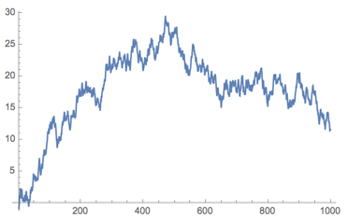
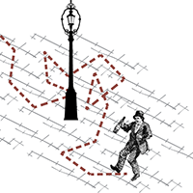
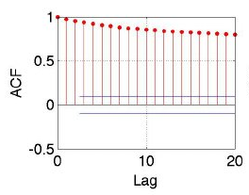
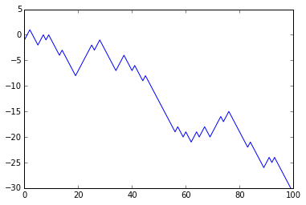
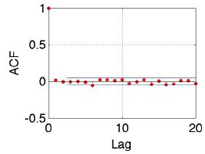
Simplest ARIMA: ARIMA(0,0,0): WN
Simplest ARIMA with $d≠0:$ ARIMA(0,1,0): RW
Random Walk: ARIMA(0,1,0): $Z_{t}={Z_{t−1}+a}_{t}$
Nonstationary: $Z_{t}=Z_{0}+\sum_{i=1}^{t}{a_{t}},$ so we see that $Var[Z_{t}]→∞$
No mean: it wanders around
ACF: not defined, but sample ACF decreases very slowly, all levels close to one
( Recall: a RW is an “AR(1)” with $φ_{1}→1$ ).
If there is a drift $θ_{0}$ (“non deterministic trend”): $Z_{t}={Z_{t−1}+θ_{0}+a}_{t}$
No mean: diverges $Z_{t}=Z_{0}+tθ_{0}+\sum_{i=1}^{t}{a_{t}}$
SUGGESTION: Practice some examples with Excel and ITSM or EViews
And differences are WN

Slide 11
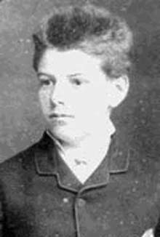
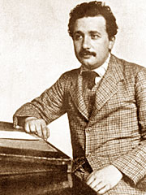
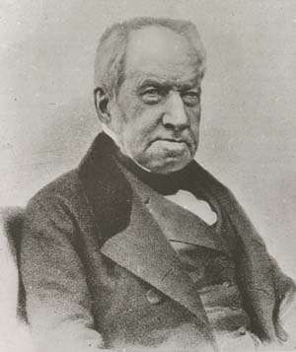
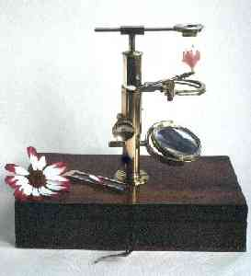
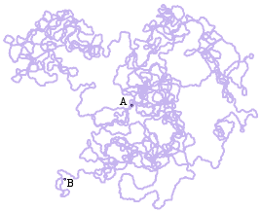
Gaussian RW in continuous time
Brownian motion
Louis Bachelier (1870-1946)
Albert Einstein (1879-1955)
Robert Brown (1773-1858) 1827

Slide 12
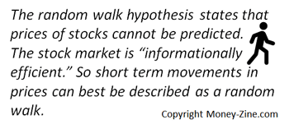

Slide 13
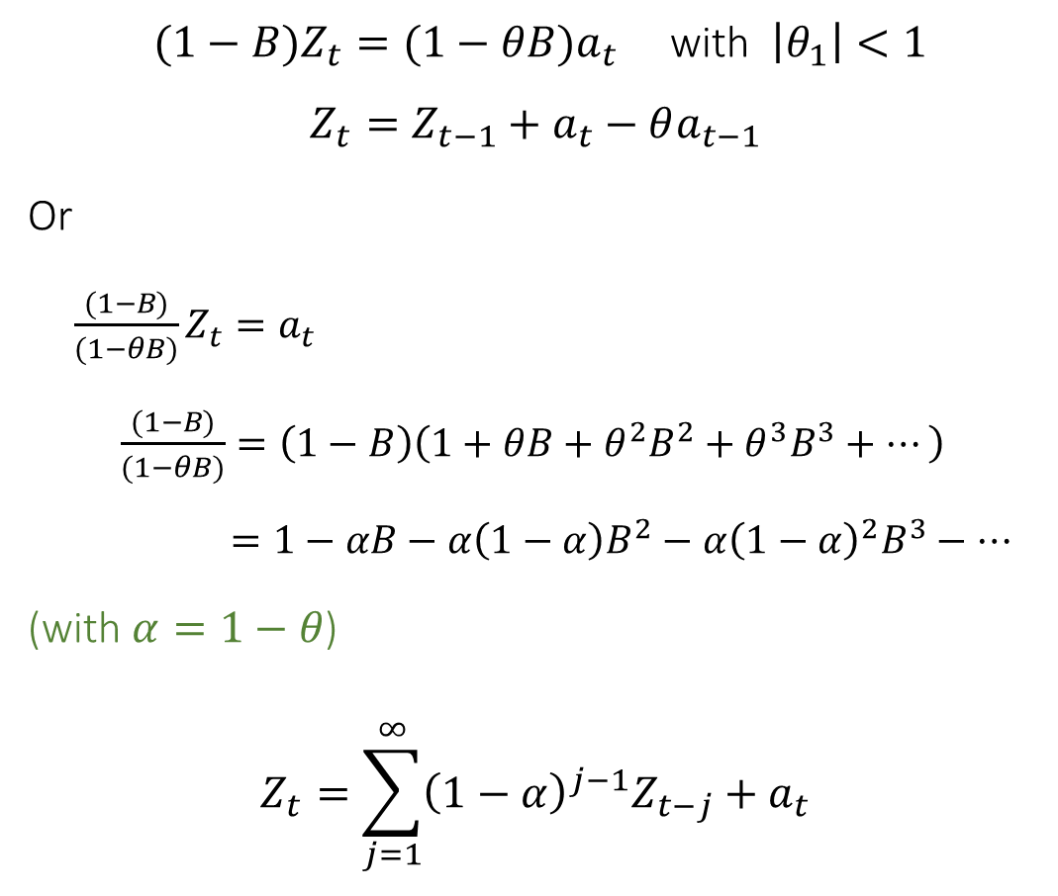
A particularly interesting ARIMA: ARIMA(0,1,1) or IMA(1,1)
One-step ahead forecast made at time $t$
Wei’s notation: $\hat{Z_{t}}(1)$
$(1−B)Z_{t}={(1−θB)a}_{t}$ with $\left|θ_{1}\right|<1$
$$Z_{t}={Z_{t−1}+a}_{t}−θa_{t−1}$$
Or
$\frac{(1−B)}{(1−θB)}Z_{t}=a_{t}$
$\frac{(1−B)}{(1−θB)}=\left(1−B\right)\left(1+θB+θ^{2}B^{2}+θ^{3}B^{3}+…\right)$
$=1−αB−α\left(1−α\right)B^{2}−α{\left(1−α\right)}^{2}B^{3}−…$
(with $α=1−θ$)
$$Z_{t}=\sum_{j=1}^{∞}{{\left(1−α\right)}^{j−1}Z_{t−j}+a_{t}}$$
$${\hat{Z}}_{t+1|t}=\sum_{j=1}^{∞}{{\left(1−α\right)}^{j−1}Z_{t−j}}$$
$=αZ_{t}+\left(1−α\right)\sum_{i=1}^{∞}{{\left(1−α\right)}^{i−1}Z_{t−i}}$
$=αZ_{t}+\left(1−α\right) {\hat{Z}}_{t|t−1}$
$={\hat{Z}}_{t|t−1}+α(Z_{t}−{\hat{Z}}_{t|t−1})$
$=last forecast+error correction$
This is known as Exponential Smoothing (or Weighting) Moving Average (EWMA). It’s a very successful forecasting technique

Slide 14
4.3. Nonstationarity in the variance (or variability)
When “local variance” or variability is proportional to the levels we can use Box-Cox transformation:
$$T\left(Z_{t}\right)=\frac{Z_{t}^{λ}−1}{λ}= \left\{\begin{aligned}{1/Z}_{t} (λ=−1) \\ \ln{Z_{t}} (λ=0) \\ Z_{t} (λ=1)\end{aligned}\right.$$
Note that $\lim_{λ→0}\left(\frac{Z^{λ} − 1}{λ}\right)=\ln\left(Z\right)$. Prove it!
Note also that $\ln\left(Z_{t}\right)−\ln\left(Z_{t−1}\right)≈(Z_{t}−Z_{t−1})/Z_{t−1}$ are returns, or relative growth rates.
Airline passengers
Log Airline passengers
Differenced log Airline passengers

